Slide 1

Advanced SQL
STAT 474 – Techniques for Large Data Set
Notes:
Are your classroom colors different than what you see in this template? That’s OK! Click on Design -> Variants (the down arrow) -> Pick the color scheme that works for you!
Feel free to change any “You will…” and “I will…” statements to ensure they align with your classroom procedures and rules!

Slide 2
Brief Recap
Join operators allowed to combine tables.
Cartesian product, inner/natural join, left/right/full join, self-join.
NULL value
Has its own semantic
Comparison operators involve NULL will return NULL
Subqueries
A query within another SQL statement.
Powerful, flexible, but hard to optimize for performance

Slide 3
Views
Nested queries can be complex, but hard to “debug” if errors occur.
A possible remedy: Break down into intermediate tables (esp. for non-correlated subqueries)
Drawback:
New tables use up storage, even though they can be recomputed from other tables
Stored output tables might be out of date if other tables get updated
A view is simply a mechanism for querying data, but do not involve data storage.

Slide 4
Using views in SQL
To create a view, use: CREATE VIEW <name> AS <SELECT statement>;
Queries can use view as if it were a base table
View always up-to-date
(Re-)evaluated whenever a query uses the view
Keeping it up-to-date is responsibility of the DBMS, not the users
DROP VIEW command to remove a view

Slide 5
Example of View
Use the R script from Blackboard

Slide 6
Updating a View
Views are updateable.
Use INSERT or UPDATE to add or modify rows in base table.
DELETE applied on view can remove rows in base table
Not all views are updateable. Condition for updatability
No aggregate functions are used
Views don’t employ GROUP BY or HAVING
No subqueries exist in the SELECT or FROM clause
Any subqueries in WHERE clause don’t refer to tables in the FROM clause
No UNION, UNION ALL, or DISTINCT
The FROM includes tables or updateable views or INNER JOINS

Slide 7
More on Views
Views can help:
Simplify queries
Make complex queries more readable
Share “SQL programs” with other people.
Potential issues:
Creating a new view for each query will result in a lot of views
Example: temp1, temp1_joey, temp1_joey_fixed, …
Often you will not allowed to create views (due to data security)

Slide 8
Common Table Expressions
Think of these as a view that exists only within a single query
Syntax: WITH <name> {(renamed columns)] AS (<SELECT statement>) [ , <name2> AS (<SELECT statement>, …]
Can define one or more CTEs with WITH clause
Can defined recursively, but … it is hard to understand and code.

Slide 9
Example of CTEs
Consider the two tables: department (dept_id, name) employee (id, name, salary, dept_id) Want: List department with ID, name and number of their employees.
WITH stat_dept(dept_id, n_employees) AS ( SELECT dept_id, COUNT(*)FROM employee GROUP BY dept_id) SELECT d.dept_id, d.name, s.n_employee FROM department d INNER JOIN stat_dept s ON d.dept_id = s.dept_id;

Slide 10
Simultaneous Accessing
What happens when multiple users input, modify, extract data from DBMSs at the same time?
Example: Three activities can happen simultaneously
A teller is handling a deposit for one of your customers.
A customer is withdrawing at the ATM in the front lobby.
The bank's month-end application is applying interest to the accounts.
Locking: disable read/write table (row or column) until it is unlocked.
Versioning: Consistent view of the data (even though others might have modified them)
Notes:
Locking : doesn’t allow to change

Slide 11
Transactions
A transaction is a sequence of one or more queries (operations), which is treated as if it is a single query.
A transaction either happened completely or not at all.
Examples:
Transfer money between accounts
Purchase a group of products
Register for a class (either wait-listed or allocated)
SQL, by default, treats each statement as one transaction.
Notes:
Transaction : happened or not happened

Slide 12
Example of a transaction
Bob sends $100 to Joe
START TRANSCTION UPDATE account SET amount = amount – 100 WHERE name = ‘Bob’ UPDATE account SET amount = amount + 100 WHERE name = ‘Joe’ COMMIT
Under the hood, DBMSs handle multiple transactions simultaneously, unless there are conflicts.
Transaction property requirement: ACID

Slide 13
ACID Properties/Requirements
Atomic
Transaction either happens or not at all
Consistent
Transaction must guarantee the integrity constraints or nothing should happen.
Isolated
Effect of transactions is the same as transactions run one after another.
Durable
Once a transaction has committed, its effects remain permanent in the database (i.e., write on disk).

Slide 14
Example of isolated property
STAT TRANSACTION UPDATE account SET amt = amt + 100 WHERE name = ‘A’ UPDATE account SET amt = amt – 100 WHERE name = ‘B’ COMMIT
T1 transfers $100 from B’s account to A’s account
START TRANSACTION UPDATE account SET amt = amt * 1.06 COMMIT
T2 credits both account with 6% interest payment

Slide 15
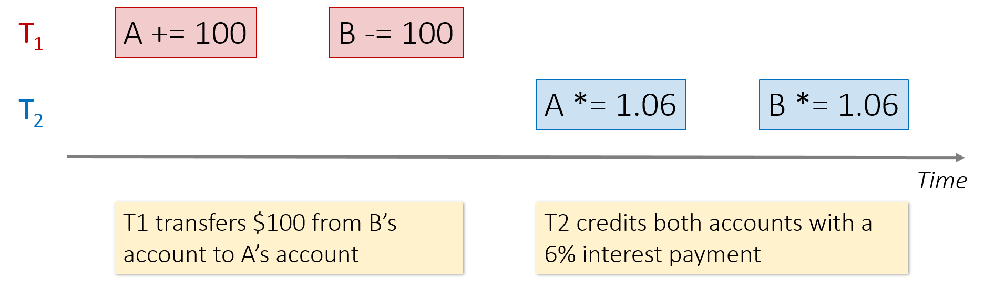
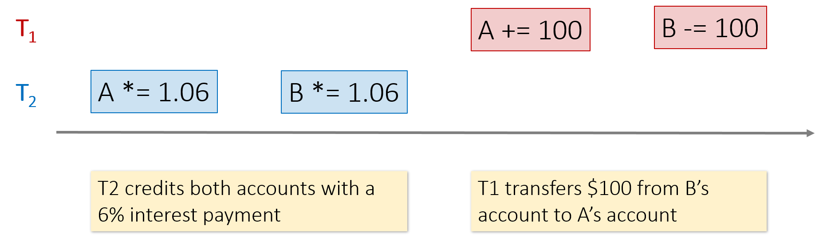
Serial Execution

Slide 16
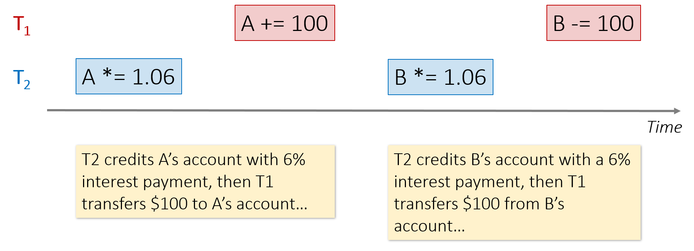
Interleaving Transactions
The DBMS has freedom to interleave transactions.
Must maintain isolation and consistency.
Help to improve performance.

Slide 17
Data and Database in Practice
How data are recorded and stored

Slide 18
A typical dataset
name | Category | Price | Date | Day | City | State | Country | sale
Corn | Food | $25 | 3/30 | Wed. | Omaha | NE | USA | 25
Galaxy | Phone | $18 | 3/30 | Wed. | Omaha | NE | USA | 18
Peanut | Food | $2 | 3/30 | Wed. | Omaha | NE | USA | 10
Corn | Food | $25 | 3/31 | Thu. | Omaha | NE | USA | 8
Galaxy | Phone | $18 | 3/31 | Thu. | Omaha | NE | USA | 20
Peanut | Food | $2 | 3/31 | Thu. | Omaha | NE | USA | 10
Galaxy | Phone | $18 | 4/1 | Fri. | Omaha | NE | USA | 10
Peanut | Food | $2 | 4/1 | Fri. | Omaha | NE | USA | 15
Peanut | Food | $2 | 3/31 | Thu. | Seoul |  | Korea | 10
Galaxy | Phone | $18 | 4/1 | Fri. | Seoul |  | Korea | 10
Peanut | Food | $2 | 4/1 | Fri. | Seoul |  | Korea | 15
Corn | Food | $25 | 4/1 | Fri. | Dallas | TX | USA | 25
Galaxy | Phone | $18 | 4/1 | Fri. | Dallas | TX | USA | 18
Peanut | Food | $2 | 4/1 | Fri. | Dallas | TX | USA | 10

Slide 19
Database Normalization
Normalization is the process of structuring a relational database in accordance with normal forms
Helps to reduce data redundancy and to improve data integrity (i.e., avoid undesirable side-effects)
Update anomaly: When same information are expressed on multiple rows and not all of them get updated.
Insertion anomaly: when certain facts cannot be recorded at all. (e.g., student can’t take course without admitted to a university).
Deletion anomaly: when deleting data that present in many tables.

Slide 20
Restructured data set
Sale
Location
Pid | Timeid | Locid | Sale
1 | 1 | 1 | 25
2 | 1 | 1 | 18
3 | 1 | 1 | 10
1 | 2 | 1 | 8
2 | 2 | 1 | 20
1 | 2 | 1 | 10
2 | 3 | 1 | 10
3 | 3 | 1 | 15
3 | 2 | 2 | 10
1 | 3 | 2 | 10
3 | 3 | 2 | 15
1 | 1 | 3 | 25
2 | 1 | 3 | 18
3 | 1 | 3 | 10
Locid | City | State | Country
1 | Ohama | NE | USA
2 | Seoul |  | Korea
3 | Dallas | TX | USA
Products
Pid | Pname | Category | Price
1 | Corn | Food | 25
2 | Galaxy | Phone | 18
3 | Peanut | Food | 2
Time
Timeid | Date | Day
1 | 3/30 | Wed.
2 | 3/31 | Thu.
3 | 4/1 | Fri.
Notes:
Data normalization : break down big table into simpler dataset

Slide 21
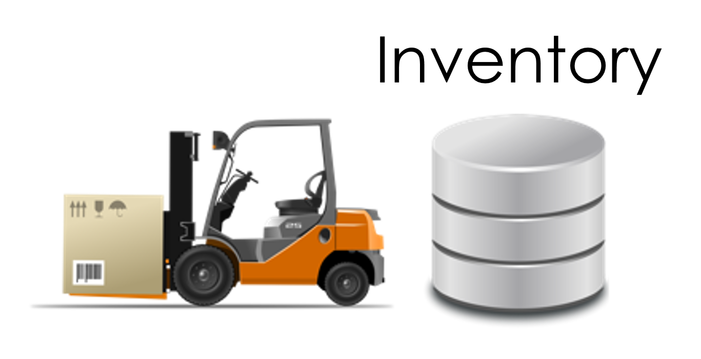

Data in an Organization
So far, database models data serving one specific purpose:
In reality ……

Slide 22
Databases in reality
Capture the now
Many different databases across an organization
Mission critical
Serving live ongoing business operations
Managing inventory
Different format (e.g., currency), different schema (acquisitions...)
Live systems often don't maintain history

Slide 23
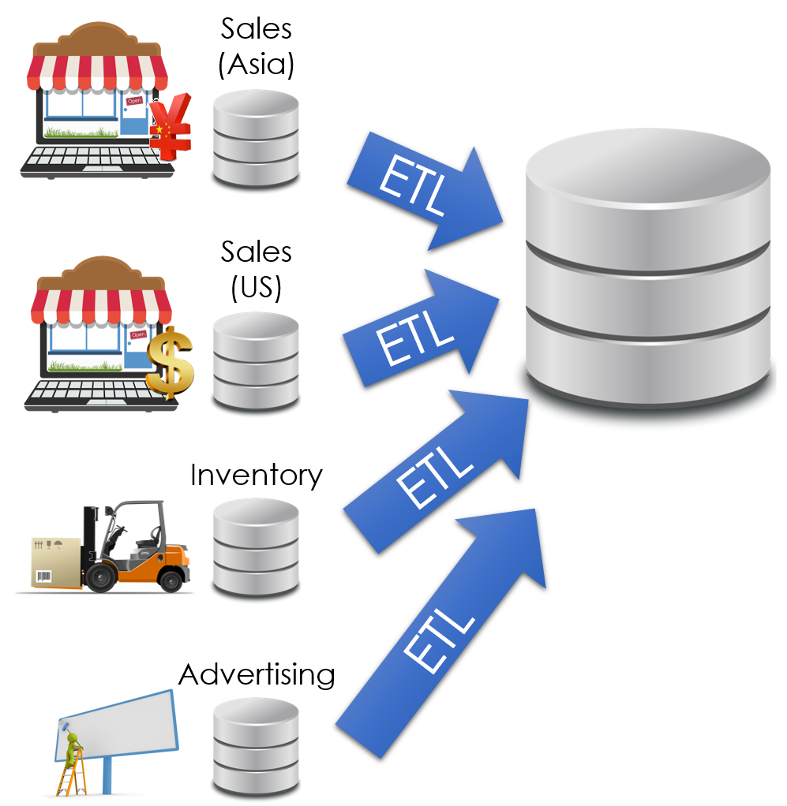
Data Warehouse
Data is periodically ETLed into the data warehouse:
Extracted from remote sources
Transformed to standard schemas
Loaded into the (typically) relational (SQL) data system

Slide 24
Extract → Transform → Load (ETL)
Extract & Load: provides a snapshot of operational data
Historical snapshot
Data in a single system
Isolates analytics queries (e.g., Business Analytics) from business critical services (e.g., processing user purchase)
Easy!
Transform: clean and prepare data for analytics in a unified representation
Difficult → often requires specialized code and tools
Different schemas, encodings, granularities
Notes:
Transform : more time to clean up data

Slide 25
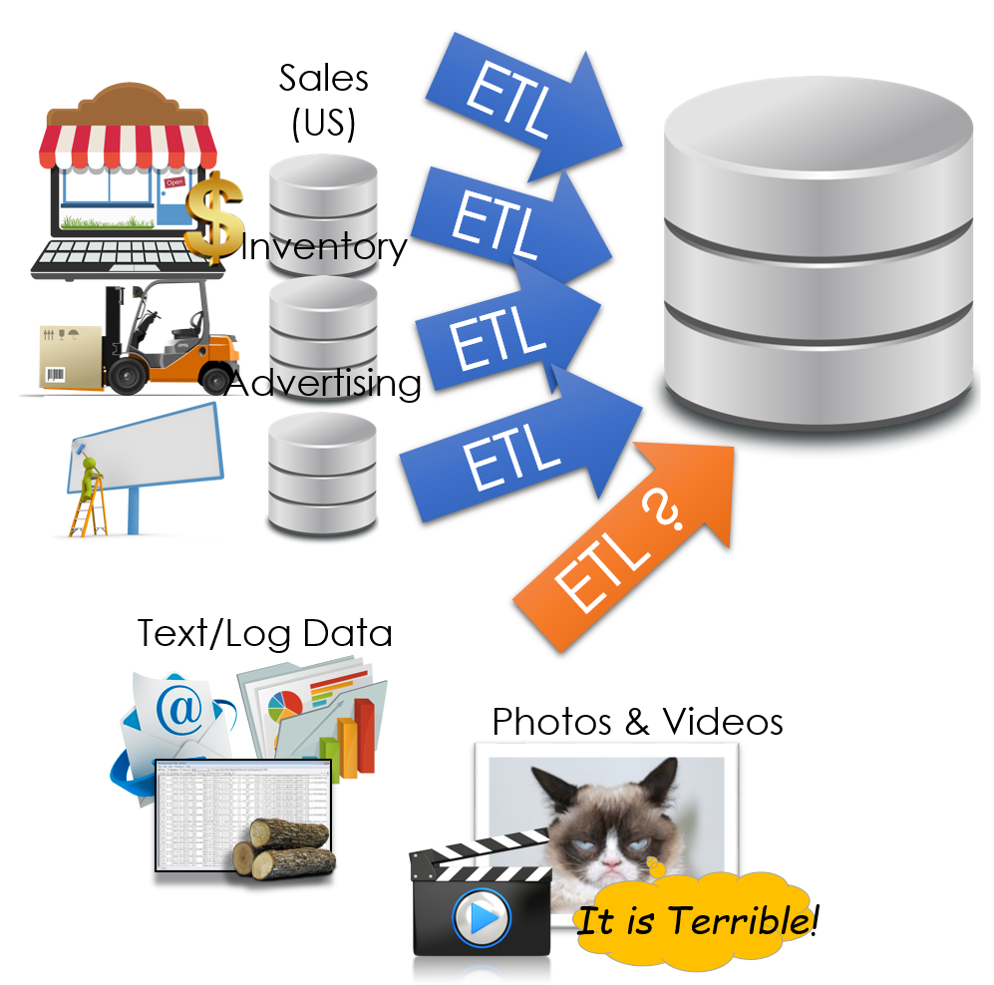
Challenge to Data Warehouse
How do we deal with semi-structured and unstructured data?
Do we really want to force a schema on load?
A binary large object (BLOB)
Notes:
BLOB: To store text, video, all the media

Slide 26
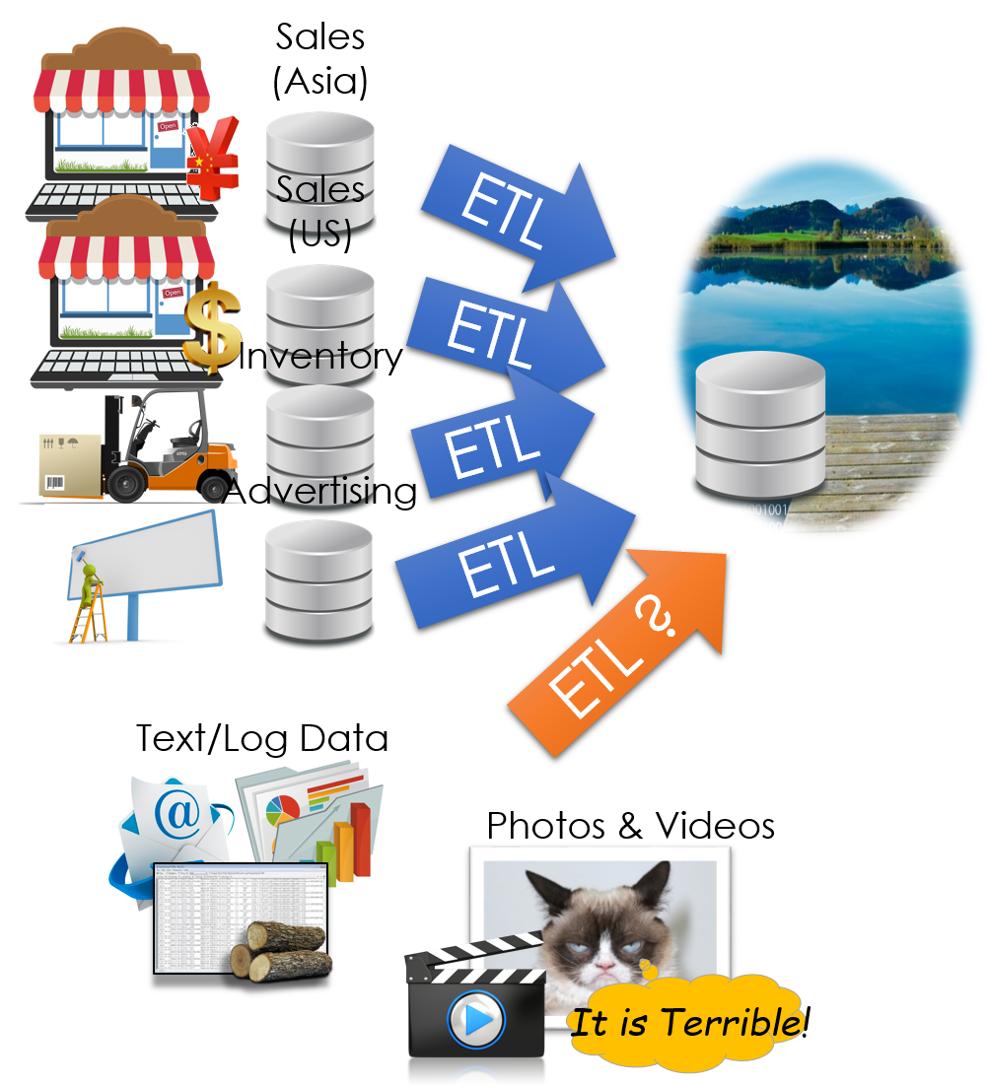
Data Lake
Still being defined...
Store a copy of all the data
in one place
in its original “natural” form
Enable data consumers to choose how to transform and use data.
Schema on Read
Notes:
Data lake : Place where u Store everything

Slide 27
Dark Side of Data lakes
Cultural shift: Curate → Save Everything!
Noise begins to dominate signal
Limited data governance and planning
Example: important/joseph_big_file3.csv_with_json
What does it contain?
When and who created it?
No cleaning and verification → lots of dirty data
New tools are more complex and old tools no longer work

